Slide 1
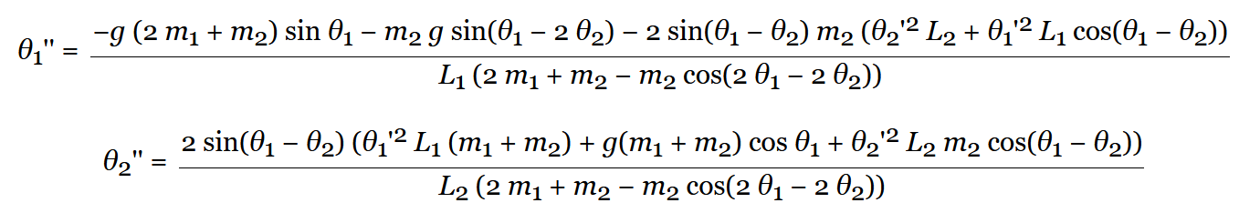

Slide 2
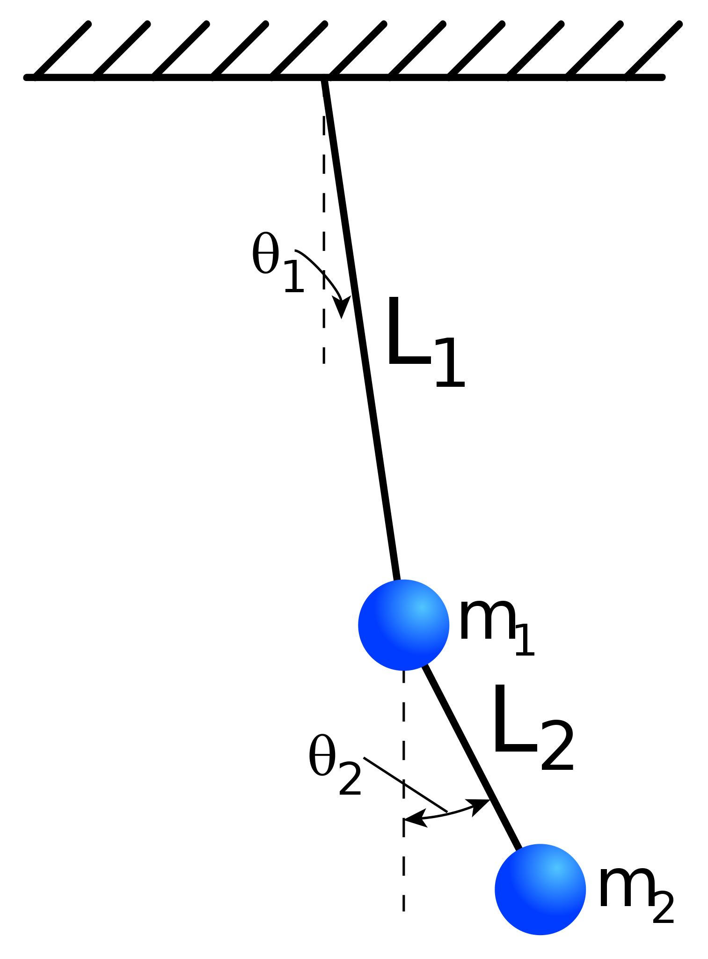

Slide 3


Slide 4

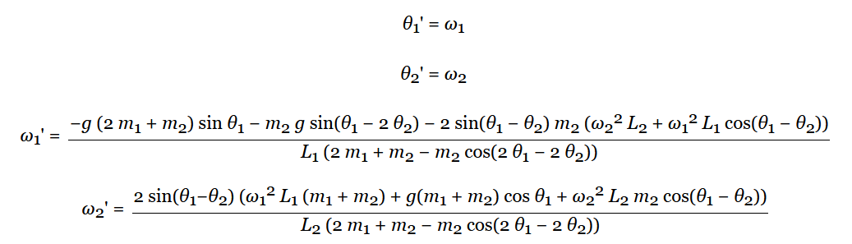
Pendule double
https://editor.p5js.org/sylvainberube/sketches/jEx3SgYKa
https://www.youtube.com/watch?v=lc8I-u9kwiQ&t=54s
https://codepen.io/Grilly86/pen/yvoVja

